Slide 1
Reid Horuff Stephen George Gavin Haynes
Real-Time Bus Tracking

Slide 2
Introduction
Android app to track position of Texas Tech buses in real-time
App notifies users when a bus is approaching their stop
Android phone on bus acts as real-time GPS transmitting device

Slide 3
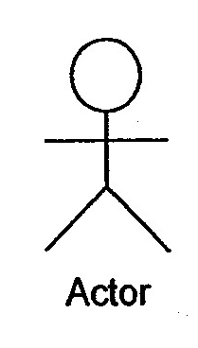
Use Case Diagram
Get Location from Phone
Send Location to Server
Include
Tracker Mode
Route Display
Route Selection
Receive Location from Server
Include
Display Bus Location
Include

Slide 4
Overall Software Architecture
MainActivity
GPSActivity
MapActivity

Slide 5
Requirements
Google Maps Overlay
Reid Horuff
Map overlay shall display bus routes for which the current user is subscribed
Map overlay shall include markers denoting bus stops
Map overlay shall include zero or more directional markers denoting the Bus’ position
Map overlays with no current bus tracking data shall be rendered in red

Slide 6
Use Case-Reid
View Active Bus Route
View Inactive Bus Route

Slide 7
Class Diagram-Reid
MapActivity
PolyLine
LatLng
Array:PolyLines
Array:LatLng
Double:Lat
Double:Lng
onCreate()
add()
color()
width()

Slide 8
Code Modified-Reid
Filename | Code Modification
MapActivity.java | Added code to render routes.
activity_map.xml | Code to define layout

Slide 9
Requirements- Gavin Haynes
Shall display updates from Location Listener.
Shall save Coordinates in 2 separate arrays for Longitude and Latitude.
Shall send data to server.

Slide 10
Use Case-Gavin Haynes
Save Current Location to Array
View Updated Location
Include
Include
On Location Change
Monitor Location
Extends

Slide 11
Class Diagram-Gavin
GPSActivity
Location Listener
locationListener
Double:currentLat
Double:currentLng
Array:Lat
Array:Lng
Location Manager
onCreate()
onResume()
onPause()
onLocationChange()
onStatusChanged()
onProviderEnable()
onProviderDisable()
getLastKnownLocation()

Slide 12
Code Modified-Gavin
Files | Code Modified
GPSActivity.java | Used to extend the Location Listener for receiving location updates. Also used to send text to activity_main.xml to display
activity_gps.xml | Used to display Latitude and longitude of current location and the array of previous locations.

Slide 13
Requirements-Stephen Map overlay/user location/Menu
The application shall display a UI and map of the user’s location (which is static at the moment).
The map shall be to display the location of the individual on the Map.
The menu shall display options to different views (Map and Location).

Slide 14
Use Case Description-Stephen
Name: BusTrackerMap
Participating Actor: User
Entry Condition
User has Android device with 3.2 and above.
Downloaded .apk file for the application.
Exit Condition
User can view the map.
Can also access location/menu.
Flow of Events
The user downloads/installs .apk files.
Opens the application in the required device.
The application displays a map of Lubbock.
Special Requirements
None

Slide 15
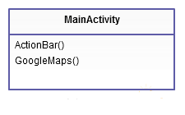
Class Diagram-Stephen

Slide 16
Code Modified-Stephen
Files | Code Modified
MainActivty.java | Used to display the ActionBar menu as well as menu options
main.xml | Contains links to .png files and layout for the UI.

Slide 17
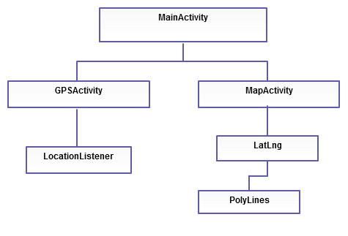
Overall Class Diagram

Slide 18
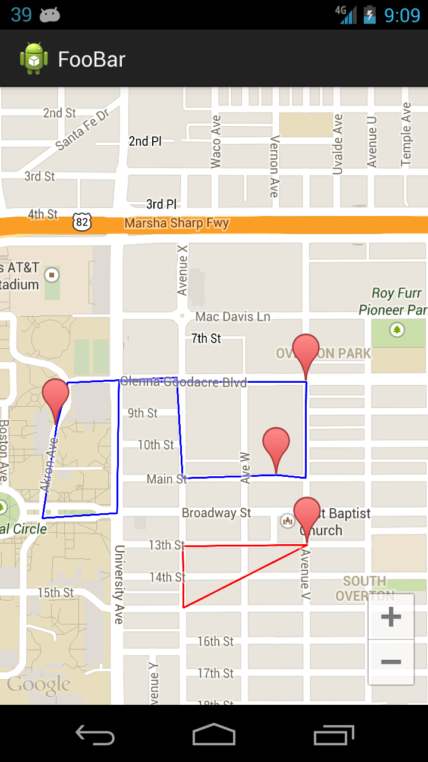
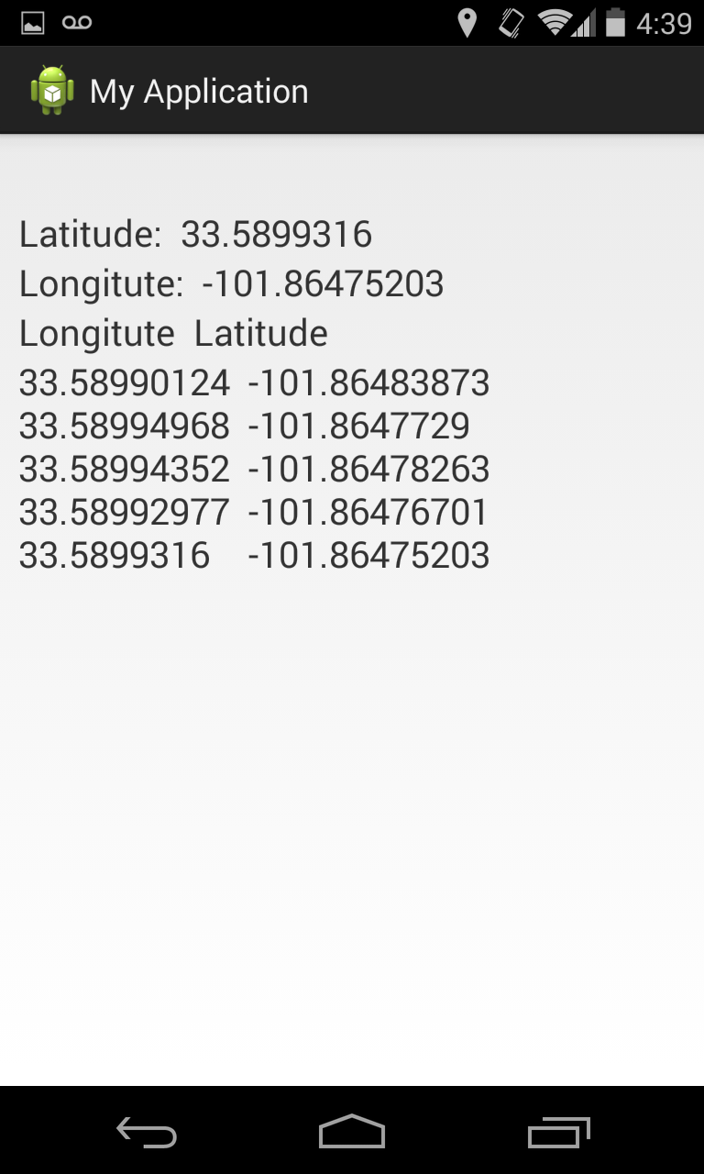
Code Demonstration
Current Coordinates
List of saved Coordinates
Bus Stop
Route with bus data
Route without bus data

Slide 19
Updated Schedule
Code Presentation | Objective
1 (today) | Demonstrate prototyping of major mobile components
2 | Implement server and demonstrate ability to store routes and display buses in real-time (functioning proof of concept)
3 | MVP – software is usable for a third party; ability to record and subscribe to bus routes
4 | Additional features such as alerts, removed bugs, polish

Slide 20
Team Presentation Assignments
Slides | Team Member Responsible | Team Member Developed
Title | Gavin | Gavin
Introduction | Gavin | Gavin
Use Case Diagram | Gavin | Gavin
Overall Software Arch. | Stephen | Stephen
Requirements | All | All
Use Case Description | All | All
Class Diagram | All | All
Code Modified | All | All
Overall Class Diagram | Reid | Reid
Code Demonstration | Gavin | Gavin
Updated Schedule | Reid | Reid
Team Presentation Assignments | Stephen | Stephen

